Slide 1





MSQH 7th Edition Hospital Wide Standards: Generic Standards & Special Requirements
Presented By
Dr. Selahudeen Abd Aziz
www.msqh.com.my

Slide 2

WELCOME TO THE 7TH EDITION TRAINING
The MSQH 7th Edition was launched, grounded in the IEEA Principles.
This edition introduces a centralised training approach to ensure consistent understanding across all hospital departments and leadership teams.
  Centralized training
  Package 1 and Package 2 (GAP Analysis) - Optional / Recommended for 1ˢᵗ Cycle
  Individual/ Set of services - Optional
  Consultant Talk - Optional
  Mock Survey or selected services - Optional

Slide 3

ACCREDITATION AS A BALANCING ACT
Balance Resources with Scope of Services
Effective accreditation requires balancing three critical dimensions: Resources, Scope of Services, and Level of Care. Hospitals must align capacity with service delivery to maintain quality standards consistently across all departments and patient touchpoints.
Align Level of Care to Patient Needs
Continuous Quality Improvement as Core
Continuous quality improvement forms the core of this balancing act. Accreditation drives risk reduction and enhances patient safety by embedding structured governance, accountability, and evidence-based practices throughout the organisation.
Accreditation Reduces Risk & Enhances Safety

Slide 4




MSQH AIMS SYSTEM OVERVIEW
Evidence of Compliance
Compliance Tracking
The AIMS (Accreditation Information Management System) supports centralised evidence collection and compliance tracking, enabling hospitals to manage documentation efficiently and maintain real-time visibility of accreditation status.
AIMS
AIMS improves survey readiness through transparent reporting and centralised documentation. It aligns hospital operations with MSQH 7th Edition standards, ensuring consistent quality monitoring and continuous improvement across all departments.
Survey Readiness
Real-Time Monitoring

Slide 5

FOCUS ON QUALITY CARE & PATIENT SAFETY
Patient safety as a core risk reduction activity
Quality care as the foundation for accreditation
Although the accreditation process mainly focuses on structure, process and continuous quality improvement at its core it is a risk reduction activity.
The underlying principle is that when healthcare organization meet or surpass the required accreditation standards, then errors and adverse events are less likely to occur.
Alignment with national and international benchmarks
Proactive culture of continuous improvement

Slide 6

PATIENT SAFETY
Malaysia's commitment to patient safety is anchored in global and national frameworks. MSQH aligns with the WHO World Alliance for Patient Safety, adopting international best practices to reduce harm and improve care quality across all hospital settings.
•MSQH is a member of the Malaysian Patient SafetyCouncil (est. 2003) - strategies and action plans developed is adopted and given emphasis in the MSQH Hospital Accreditation Standards and Compliance assessment. *NEW Patient for Patient Safety Goals

Slide 7
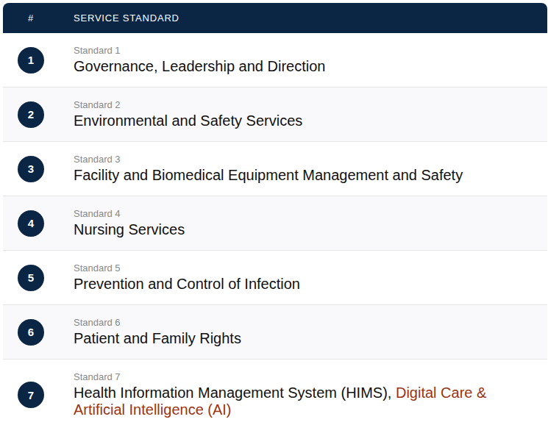
1
Organisation & Management
HOSPITAL WIDE STANDARDS FRAMEWORK OVERVIEW
The MSQH 7th Edition introduces 7 Hospital Wide Standards covering all aspects of hospital operations, governance, and patient care delivery.
2
Human Resource Development & Management
3
Policies, Procedures & Guidelines
4
Facilities, Equipment & Safety
5
Performance Improvement Activities

Slide 8
Workforce Wellbeing
Physical, mental, and spiritual wellbeing of staff. Psychological safety, supportive culture, and promoting staff engagement and retention.
Business Continuity Plan (BCP)
Risk register, business impact analysis, critical service continuity, and regular drills to ensure operational resilience during disruptions.
WHAT'S NEW IN THE 7TH EDITION
The MSQH 7th Edition introduces four major new focus areas that reflect evolving healthcare priorities, global best practices, and modern hospital management.
Sustainable Healthcare
Resource optimisation, waste reduction, and sustainable care delivery models. Environmental stewardship as a core strategic goal.
Digital Care & Artificial Intelligence
Electronic Medical Records (EMR), cybersecurity, data protection, AI governance, and staff competency development.
Each new addition expands the scope of accreditation standards to ensure hospitals are resilient, people-centred, environmentally responsible, and digitally prepared for the future.

Slide 9




BUSINESS CONTINUITY PLAN ESSENTIALS
Risk Register
Business Impact Analysis
  In line with Preparedness and Response Plan to the emergency, crisis, disaster or outbreak
  More details on the service continuity plan: Contingency Plan/ emergency plan to continue the patient care
  To maintain critical emergency functions during service disruptions.
  The plan shall be based on service priorities and potential risks, and include key actions, responsible staff, and alternative arrangements to continue care.
BCM
Alternative Arrangements
Drills & Testing

Slide 10
1
Basic Governance & Awareness
ANTI-MICROBIAL STEWARDSHIP
PROGRESSION OVERVIEW
2
Intermediate Optimisation
AMS requirements have evolved significantly from the 6th to 7th Edition, reflecting a structured three-level progression toward comprehensive stewardship excellence.
3
Advanced Implementation
Each level builds upon the previous, ensuring hospitals systematically strengthen antibiotic governance, optimise prescribing practices, and implement advanced audit and surveillance capabilities.
Audits & Surveillance Data
4
5
Continuous Improvement

Slide 11

AMS LEVEL 1
BASIC REQUIREMENTS
HIACC and AMS Policy
AMS Level 1 establishes the foundational governance framework for Antimicrobial Stewardship. Hospitals must have an active HIACC committee and a formal AMS policy endorsed by hospital leadership to guide responsible antibiotic use across all clinical departments.
AMS Team Formation
Surveillance and Feedback
Surveillance systems must be in place to monitor antibiotic consumption and resistance patterns. Regular feedback to clinical teams and structured awareness campaigns promote a culture of stewardship and responsible prescribing from the ground up.
Awareness Campaigns

Slide 12
AMS LEVEL 2
INTERMEDIATE STRATEGIES
Streamline
Antibiotic Use
Dose & Route
Optimisation
AMS Level 2 focuses on optimising antibiotic use through targeted interventions, prospective audits, and evidence-based guideline adoption to reduce resistance and improve patient outcomes.
AMS
LEVEL 2
Hospitals at this level implement dose and route optimisation, streamline prescribing practices, and adopt national and international antibiotic guidelines to drive continuous stewardship improvement.
Prospective
Audits
Guideline
Adoption

Slide 13

AMS LEVEL 3
ADVANCED IMPLEMENTATION
Level 3 represents full Antimicrobial Stewardship program maturity integrating data-driven audits, prescribing analytics, and formulary controls to achieve measurable outcomes in antibiotic optimisation and resistance reduction.
Point Prevalence Surveys (PPS)
Prescribing Appropriateness Monitoring
Formulary Restrictions & Controls
Physician-Specific Data Dissemination

Slide 14

CONTINUITY OF CARE IN CLUSTER HOSPITALS

Slide 15
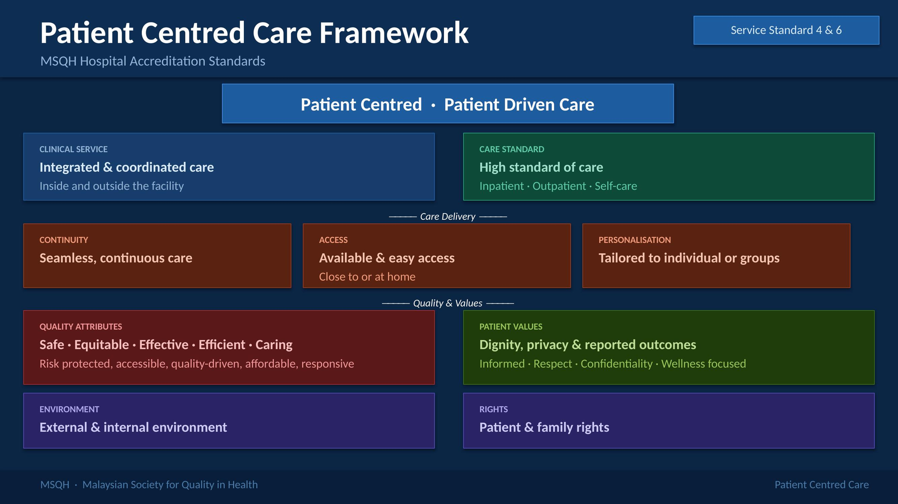
CLUSTER SERVICE GOALS

Slide 16
CLUSTER SERVICE REQUIREMENTS
Credentialing & Privileging Consistency across cluster facilities
Staff Training & Competency Monitoring
Credentialing and privileging must be consistent across all cluster facilities, ensuring every clinician meets defined competency standards before providing care within the cluster network.
Cluster Management Committee Oversight
Integrated Quality & Safety Standards
The Cluster Management Committee provides oversight of service coordination, quality monitoring, and governance alignment across all cluster hospitals to ensure seamless, standardised care delivery.

Slide 17
SERVICE STANDARD PREAMBLES
Governance & Leadership
Facilities & Nursing Care
Strong governance structures and accountable leadership are foundational to each service standard. Clear lines of authority, defined roles, and active governing body oversight ensure consistent quality and safety across all hospital services.
Infection Control Measures
Patient Rights & Digital Care Integration
Infection prevention and control measures are embedded throughout all service standards. Hospitals must demonstrate robust IPC protocols, surveillance systems, and staff compliance to reduce healthcare-associated infections and protect patient safety.
Adequate facilities, equipment, and nursing care standards underpin safe service delivery. Each preamble emphasises fit-for-purpose environments, maintained equipment, and competent nursing staff aligned to the scope of services provided.

Slide 18

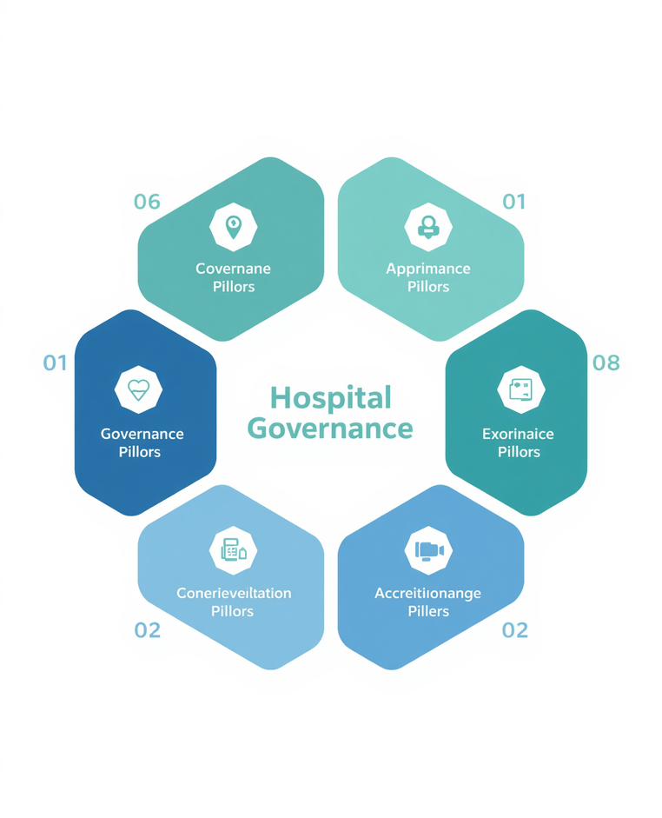

AREAS OF CONCERN: SIX KEY PILLARS
The MSQH 7th Edition Hospital Wide Standards are structured around six core areas of concern. Each pillar represents a critical domain of hospital governance, operations, and patient safety that must be addressed to achieve and maintain accreditation.
Organisation & Management
Human Resource Development & Management
Safety & Performance Improvement Activities
Policies & Procedures
Special Requirements
Facilities & Equipment

Slide 19
1
Vision & Mission Statements
EVIDENCE OF
COMPLIANCE
2
Organisation Charts & Appointment Letters
Compliance evidence follows the Standard → Intent → Evidence format. Documentation must be current, accessible, and demonstrate consistent implementation across all hospital departments.
3
Terms of Reference & Meeting Minutes
All evidence must be organised, dated, and readily available during MSQH surveys. Digital records via AIMS system are accepted alongside physical documentation for audit purposes.
Policies & Procedures Documents
4
5
Audit Reports & Quality Records

Slide 20




GOVERNANCE TO OUTCOMES
Strong Governance
Safe Care Delivery
Strong governance is the foundation of safe, high-quality care. When leadership structures are clear and accountable, care delivery improves and patient outcomes are measurably better.
CORE PRINCIPLE
This principle underpins all MSQH 7th Edition Hospital Wide Standards embedding governance, safety, and continuous improvement as interconnected pillars of accreditation excellence.
Better Patient Outcomes
Continuous Improvement

Slide 21
ORGANISATION & MANAGEMENT
1.1 PREAMBLE
Quality & Safety Governance
Business Continuity Management (BCM)
The governing body is accountable for ensuring quality, safety, sustainability, and organisational resilience. Leadership must embed a culture of continuous improvement aligned with MSQH 7th Edition standards and national healthcare goals.
Digital Transformation & Cybersecurity
Environmental Sustainability Commitments
Strong governance integrates all four pillars quality & safety, BCM, digital care, and sustainability into a unified leadership framework that drives safe care and better patient outcomes across the organisation.
BCM ensures critical services continue during disruptions. Digital transformation requires robust cybersecurity policies, EMR governance, and staff competency in digital tools. Environmental stewardship is now a strategic leadership commitment.

Slide 22

STANDARD 1.1.1
GOVERNING FRAMEWORK
Facility operational policies in place and accessible
Medical Staff By-Laws approved by governing body
The governing framework ensures the facility operates under clearly defined policies, by-laws, and legal mandates. It establishes accountability structures from the governing body down to operational management, ensuring compliance with national healthcare regulations and MSQH standards.
Business Continuity Management (BCM) program established
Evidence of compliance includes: operational policies accessible to all staff, Medical Staff By-Laws endorsed by MAC and governing body, BCM program documentation, valid facility license, and formal PIC appointment letter with qualifications verified.
Valid license to operate and formal PIC appointment

Slide 23

VISION, MISSION & STRATEGIC GOALS
Vision and mission statements are reviewed every 4 years to ensure alignment with evolving healthcare priorities. Strategic goals reflect the hospital's commitment to equity, safety, and sustainability under the MSQH 7th Edition framework.
Reviewed every 4 years for relevance
Health equity as a strategic priority
Patient safety culture embedded in goals
Environmental stewardship & sustainability

Slide 24
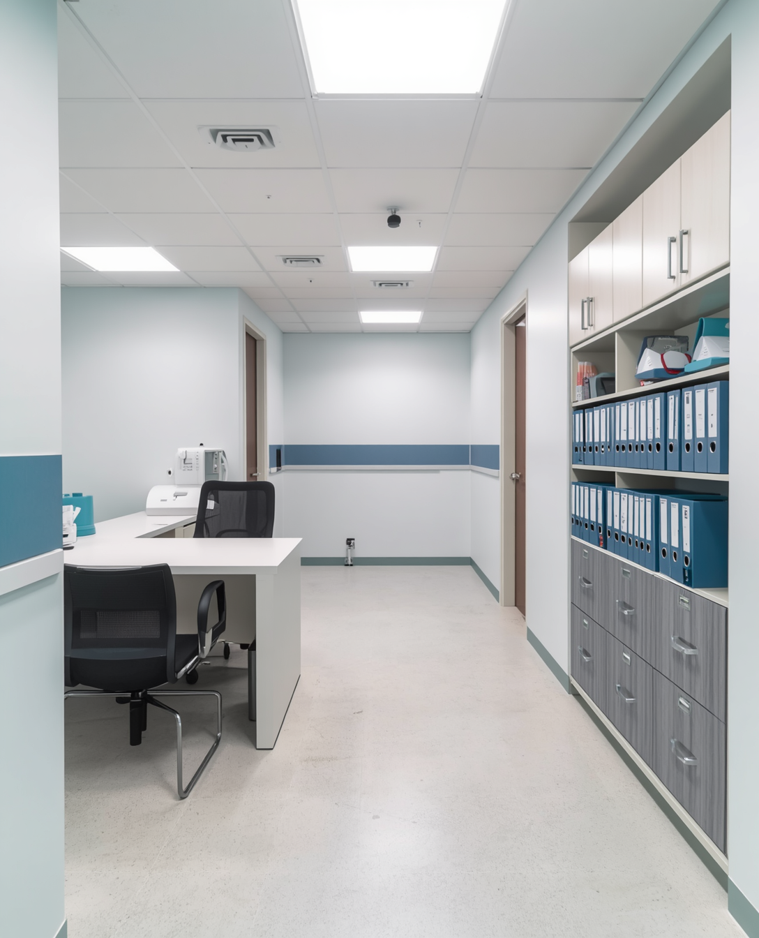
GOVERNING FRAMEWORK DETAILS
License to operate compliance
PIC appointment and role clarity
The facility must maintain a valid license to operate at all times. The Person-in-Charge (PIC) must be clearly appointed with defined roles, qualifications, and accountability aligned to regulatory and MSQH requirements.
Operational policies accessibility
Document control and version management
All operational policies must be documented, current, and readily accessible to relevant staff. Policies should reflect actual practice, be reviewed regularly, and support consistent, safe, and compliant service delivery across the facility.

Slide 25
1
Governing Body
LEADERSHIP ACCOUNTABILITY MODEL
2
PIC / Hospital Director
A clear hierarchy ensures defined roles, responsibilities, and accountability at every level of hospital leadership from governance to clinical service delivery.
3
Management Team
Each tier is accountable to the one above, with transparent reporting lines and documented authority. Strong governance at the top enables safe, quality care at every level.
Clinical Services
4
5
Support & Operations

Slide 26

PIC APPOINTMENT & QUALIFICATIONS
STANDARD 1.1.2
The Person-in-Charge (PIC) plays a critical leadership role in ensuring hospital compliance and quality governance. Key qualification requirements include:
• Valid medical degree from a recognised institution
• Full registration with the Malaysian Medical Council (MMC)
• Appropriate clinical and managerial training
• Demonstrated leadership experience in healthcare settings
The PIC is accountable for the overall management, safety, and quality of care delivered within the facility. Appointment must align with the Private Healthcare Facilities and Services Act (PHFSA) requirements, ensuring the right leader is in place to drive accreditation readiness and continuous improvement.

Slide 27
CLINICAL GOVERNANCE STRUCTURE
Designated Specialty Heads
Appointed leads for each clinical department with defined authority
Clear Reporting Lines
Structured accountability from clinical leads to MAC and PIC
Clinical governance ensures that designated heads lead each specialty with clear accountability. Reporting lines are defined to support quality oversight, patient safety, and consistent clinical standards across all hospital departments.
Credentialing & Privileging
Oversight of clinical competency and scope of practice
Quality & Safety Oversight
Clinical governance linked to performance improvement activities
Each clinical service head is responsible for credentialing, performance monitoring, and adherence to clinical protocols. Clear reporting structures connect clinical leads to the Medical Advisory Committee and hospital leadership.

Slide 28

HOSPITAL ORGANISATION CHART REQUIREMENTS
A clear and accessible organisation chart is essential for effective governance. It must define all functions, roles, and reporting relationships across every level of the hospital from the Governing Body to frontline clinical and support services.
✦ Clear functions and reporting lines at all levels
✦ Accessible to all staff at any time
✦ Reflects actual operational structure
✦Supports accountability and transparency in governance

Slide 29
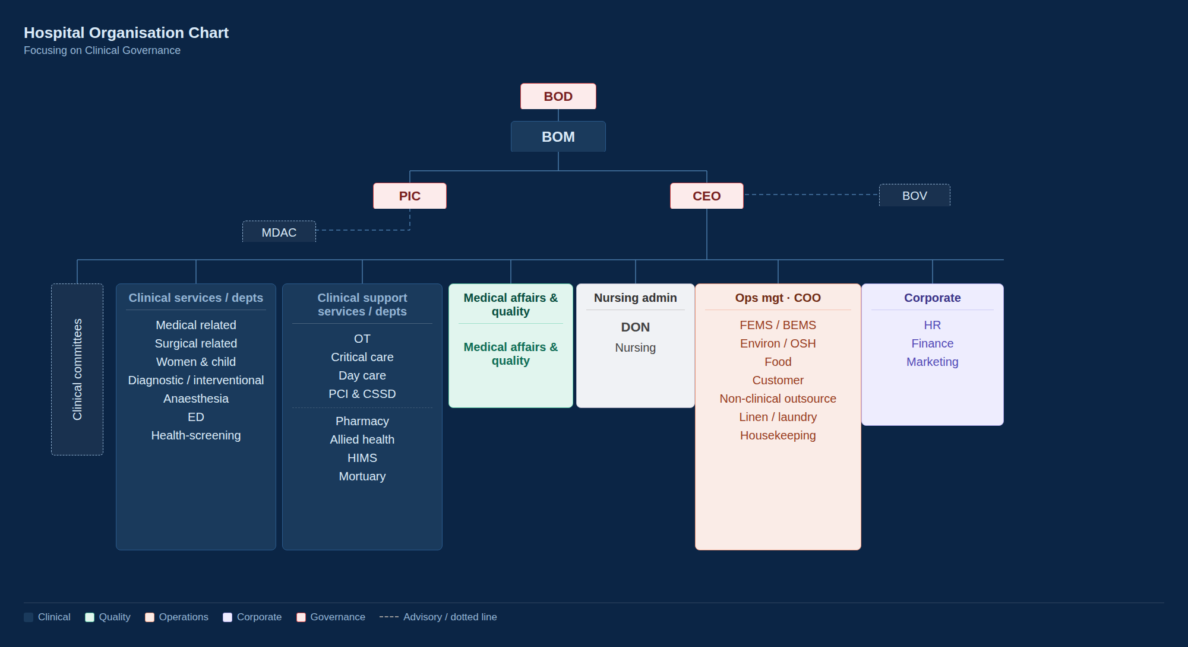

Slide 30

HOSPITAL ORGANISATION CHART
CLINICAL GOVERNANCE FOCUS
The hospital governance structure establishes clear lines of authority and accountability from the Board of Directors through to all clinical and support services. Each level carries defined responsibilities to ensure safe, high-quality care delivery.
Board of Directors (BOD)
Strategic oversight & ultimate accountability
Board of Management (BOM)
Operational governance & policy direction
All reporting relationships must be clearly documented, accessible to staff, and reviewed regularly. The structure aligns with MSQH 7th Edition requirements for transparent governance and clinical accountability.
PIC / CEO
Facility leadership & regulatory compliance
Clinical, Support & Operations
Service delivery & performance reporting

Slide 31
MANAGEMENT COMMITTEE
Regular meetings with documented minutes
Minutes accessible to all relevant stakeholders
Management committees must convene at regular, scheduled intervals. Meeting minutes are to be properly documented, reviewed, and made accessible to relevant staff and leadership to ensure transparency and accountability.
Information flow to governing body
Communication across facility departments
Effective information flow ensures that decisions and updates from management committees are communicated upward to the governing body and disseminated throughout the facility for consistent implementation and follow-through.
Committee functions include policy review, performance monitoring, quality improvement oversight, and coordination between clinical and administrative services to support safe and effective hospital operations.

Slide 32

MEDICAL ADVISORY COMMITTEE (MAC) ESTABLISHMENT
The MAC is a mandatory committee comprising registered medical and dental practitioners, ensuring broad representation across clinical specialties to guide quality care, policy development, and clinical governance within the hospital.
Registered medical practitioners
Representation across specialties
Registered dental practitioners included
Diverse clinical expertise and perspectives

Slide 33



MAC/MDAC
FUNCTIONS
The Medical Advisory Committee (MAC) and Medical & Dental Advisory Committee (MDAC) play a central role in clinical governance, ensuring quality, safety, and professional standards are upheld across all hospital services.
Policy & procedure development and clinical standards setting
Credentialing, privileging oversight and scope of practice
Quality improvement and patient safety monitoring
Continuing medical education and professional development

Slide 34

PRIVATE HEALTHCARE FACILITIES ACT REQUIREMENTS
Organisational plan and chart documented
Authority and responsibilities clearly defined
The Private Healthcare Facilities and Services Act mandates a clear organisational plan and chart defining authority, responsibilities, and reporting lines across all levels of hospital management.
MAC establishment with BOM representation
Compliance requires formal establishment of the Medical Advisory Committee (MAC) with Board of Management (BOM) representation, ensuring clinical governance is embedded at the highest level of the organisation.
Legal and regulatory compliance verified

Slide 35






HUMAN RESOURCE DEVELOPMENT AND MANAGEMENT
Credentialing & Privileging
Verification of qualifications, competencies, and privileges for all clinical and non-clinical staff to ensure safe and effective care delivery.
Training, Education & Staff Wellbeing
Ongoing staff training, appraisal, research support, and orientation programs. Staff wellbeing physical, mental, and spiritual is a new 7th Edition requirement.
Staffing Levels & Competency
Adequate staffing ratios and competency assessments maintained across all departments to support quality care and patient safety standards.

Slide 36


POLICIES & PROCEDURES
Documented policies and procedures are essential for compliance. They provide clear, standardized guidance for all staff, ensuring consistent and safe care delivery across every department and service.
All policies must be current, accessible, and regularly reviewed. Staff must be oriented to relevant policies and demonstrate compliance during MSQH surveys through records, audits, and direct observation.

Slide 37
FACILITIES & EQUIPMENT OVERVIEW
Proper facility management and equipment maintenance are critical components for the safe delivery of healthcare services. Hospitals must ensure that all physical infrastructure and medical equipment meet regulatory and accreditation requirements to protect patients, staff, and visitors.
Effective facilities and equipment management supports clinical excellence, minimizes risk, and ensures continuity of care. Compliance with MSQH 7th Edition standards in this domain is essential for achieving and maintaining accreditation status.

Slide 38




FACILITIES & EQUIPMENT COMPLIANCE (PHFS ACT 586)
Patient Privacy & Ventilation
Ensure patient privacy in all care areas. Adequate ventilation, utility zones, hygiene, and waste management standards must be maintained throughout the facility.
Fire Safety & Disabled Access
Fire safety systems, staff drills, and disabled access compliance are mandatory. Emergency equipment must match the scope of services provided.
Medical Device Act Compliance
All medical devices must comply with the Medical Device Act. Equipment lifecycle management, maintenance records, and safety checks are required for accreditation.

Slide 39

FACILITIES SUPPORT & PREPAREDNESS
Ensuring staff welfare, emergency readiness, and business continuity are essential pillars of a resilient and safe healthcare facility.
Staff Support
Emergency Readiness
Business Recovery
Staff rooms, rest areas, and communication systems in place. Maintenance schedules upheld for all support facilities.
Emergency, crisis, and disaster response plans documented and tested. Regular drills conducted for all staff levels.
Business continuity plan with external support networks. Service priorities and contingencies clearly defined and communicated.

Slide 40



SAFETY & PERFORMANCE IMPROVEMENT ACTIVITIES
A robust quality framework drives continuous improvement across all hospital services, ensuring measurable outcomes and clear accountability at every level.
Data Measurement & Benchmarking
Systematic collection and analysis of performance data against national and international benchmarks to identify gaps and drive quality improvement.
Accountability & Responsibility Systems
Clear lines of accountability ensure all departments own their safety programs, with defined roles, reporting structures, and performance review cycles.

Slide 41
DATA & ACCOUNTABILITY IN SAFETY PROGRAMS
Effective safety programs rely on systematic data management, clear accountability structures, and regular internal validation to drive continuous quality improvement.
Record Collection & Analysis
Information Flow & Authority
Internal Audits & Validation
Systematic collection, analysis, and secure storage of safety data to identify trends and support evidence-based decision making.
Clear channels for information flow with defined authority levels to ensure timely reporting and accountability across all departments.
Regular internal audits conducted to validate data integrity, ensure compliance, and confirm accuracy of safety program records.

Slide 42




SPECIAL REQUIREMENTS OVERVIEW
Key special requirement areas under Hospital Wide Standards covering medical records accuracy, ethical AI governance, and adoption of emerging health technologies.
Medical Records (Core)
Ethical AI Use (Non-Core)
Health Technologies (Non-Core)
Accurate patient medical records are essential. Approved abbreviations and symbols validated through on-site sampling by the Medical Records Committee.
Responsible and ethical use of AI in clinical settings. Requires governance framework, accountability, and compliance with digital care standards.
Adoption of emerging technologies such as IoMT, sensors, and robotic automation with documented risk assessment dossiers required.

Slide 43

MEDICAL RECORDS
APPROVED ABBREVIATIONS
Standardised abbreviations and symbols ensure accurate, consistent medical documentation across all hospital departments and clinical records.
Committee Approval
All approved abbreviations and symbols must be reviewed and endorsed by the Medical Records Committee to ensure compliance with documentation standards.
On-Site Validation
On-site sampling of medical records is conducted to validate correct usage of approved abbreviations and ensure staff adherence to documentation policies.

Slide 44



RISK ASSESSMENT FOR CONNECTED HEALTH TECHNOLOGIES
A structured framework to evaluate IoMT devices, sensors, and robotic automation before clinical deployment ensuring safety, efficacy, and compliance.
IoMT & Devices
Clinical Efficacy
Risk Dossier
Evaluate IoMT devices, sensors, and robotic automation for clinical suitability, privacy, cybersecurity, and workflow integration.
Assess clinical efficacy, patient safety impact, and ethical considerations before adopting emerging health technologies.
Documented risk assessment dossiers required for all connected health technologies prior to deployment and use.

Slide 45



PREHOSPITAL CARE SERVICES (PHCS)
Medical care delivered outside hospital settings, prior to patient arrival. PHCS ensures timely clinical intervention, coordination, and safe transport to appropriate care facilities.
Definition & Scope
Medical care provided outside hospitals before patient arrival includes emergency response, clinical assessment, and stabilisation in the field.
Delivery & Coordination
Covers ambulance dispatch, clinical advice, and deployment coordination ensuring seamless handover and continuity of care upon hospital arrival.

Slide 46





PHCS STANDARDS OVERVIEW (EMERGENCY SERVICES)
Dispatch & Clinical Care
Ambulance dispatch (5 criteria): call handling, triage, deployment, coordination, and response time. Clinical care (6 criteria): assessment, treatment, monitoring, documentation, handover, and safety protocols.
Ethical Practice & Equipment
Ethical practice (3 criteria): patient consent, confidentiality, and professional conduct. Equipment access (3 criteria): availability, maintenance readiness, and compliance with medical device standards.
Vehicle & Quality Standards
Vehicle maintenance (1 criterion): roadworthiness and infection control standards. Quality & safety (1 criterion): continuous performance monitoring and incident reporting.

Slide 47





SAFETY & SECURITY SPECIAL REQUIREMENTS
Fire Safety
Staff awareness training, fire detection & suppression systems, regular fire drills, and emergency evacuation procedures in place facility-wide.
Safety Programs & Disaster Management
Safety audits, incident reporting, root cause analysis, and disaster response plans with regular drills for emergency preparedness.
Waste Disposal & Security
Proper waste handling with PPE, secure lighting, security matrix, CCTV surveillance, and controlled access across all facility zones.

Slide 48


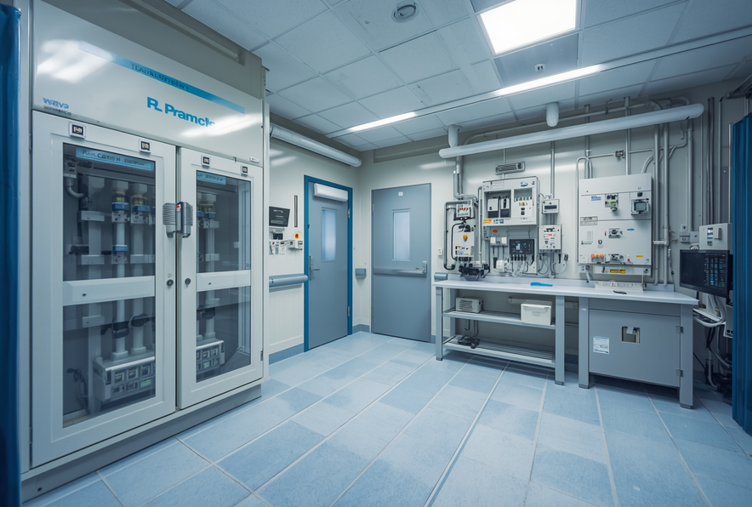


FACILITIES & EQUIPMENT SPECIAL REQUIREMENTS
Biomedical & Facility Equipment
Full lifecycle management and scheduled maintenance for all biomedical and facility equipment. Medical Device Act compliance required.
ACMV & Building Systems
Air Conditioning & Mechanical Ventilation (ACMV): cooling, exhaust, air exchange systems. Building and sewage standards maintained.
Utilities & Electrical Systems
Water supply, medical gases, electrical systems, and backup power. Continuous monitoring and documented compliance required.

Slide 49





PATIENT & FAMILY RIGHTS
Policy Communication
Rights policy communicated to all staff. Patients and families are informed of their rights upon admission and throughout their care journey.
PIC Role in Patient Rights
Person-In-Charge (PIC) ensures patient rights are upheld. Clear accountability for rights protection across all departments and services.
Respect & Dignity
Respect for patient beliefs, privacy, and dignity at all times. Protection of vulnerable groups and risk reduction for all patients.

Slide 50





PATIENT RIGHTS CONTINUED
Information on Care Process
Patients receive clear information on their care process, treatment options, and continuity of care during transfers between services or facilities.
End-of-Life & Resuscitation
Policies on withholding resuscitation and end-of-life care protocols are established, communicated, and followed with compassion and dignity.
Grievance, Consent & Research
Grievance mechanisms, informed consent procedures, and policies on research participation and organ procurement are documented and accessible.

Slide 51

Summary of Hospital Wide Standards
Governance & Leadership
01
Infection Control
05
Safety & Environment
02
Patient Rights
06
Equipment Management
03
Health Information & Digital Care
07
Nursing Care Quality
04
MSQH 7th Edition
08

Slide 52



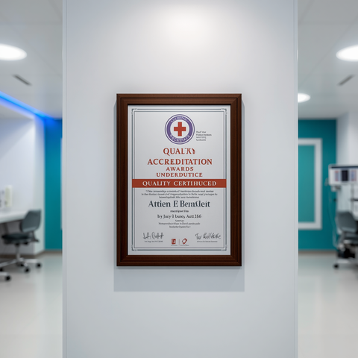

Thank You
for Your
Attention
©️ Malaysian Society for Quality in Health
All rights reserved. No part of this book may be reproduced, stored in a retrieval system, or transmitted in any form or by any means, electronic, mechanical, photocopying, recording or otherwise, without the explicit permission of the Malaysian Society for Quality in Health.
tnm@msqh.com.my
www.msqh.com.my

