Slide 1




OVERVIEW ON MSQH &
7TH EDITION
STANDARDS
Introduction to the 7th Edition Service Standards for Healthcare Facilities
Presented By
Dr. Selahudeen Abd Aziz

Slide 2




Healthcare Facilities and Levels of Services
PRESENTATION OUTLINE
Types of healthcare facilities, levels of care (Primary, Secondary, Tertiary), and the scope of services covered under MSQH accreditation standards.
This presentation provides a comprehensive overview of MSQH and introduces the 7th Edition Service Standards, covering the key pillars of healthcare quality, accreditation, and continuous improvement in Malaysia.
Philosophy, Implementation Strategies and Values
MSQH's core philosophy, the 5E implementation strategies, and the five organisational values guiding quality healthcare delivery.
The Quality Measurement Framework
The Dimension of Quality, Donabedian Operational Model, organisational quality and accountability, and the role of Continuous Quality Improvement (CQI).

Slide 3

HEALTHCARE
FACILITIES
Ambulatory Care Centres
Blood Banks
Nursing Homes
Birthing Centers
Imaging & Radiology Centers
Day Care Centers
Diabetic Education Centres
Hospice
Hospitals
Medical Clinics
Dialysis Centers
Dental Clinics
01
02
03
Types of licensed healthcare facilities providing a full spectrum of inpatient, outpatient, and specialized medical services to the community.
Facilities offering targeted clinical and therapeutic services, supporting both acute and chronic care needs across diverse patient populations.
Specialized centers providing diagnostic, palliative, rehabilitative, and education-based services to enhance patient outcomes and continuity of care.

Slide 4
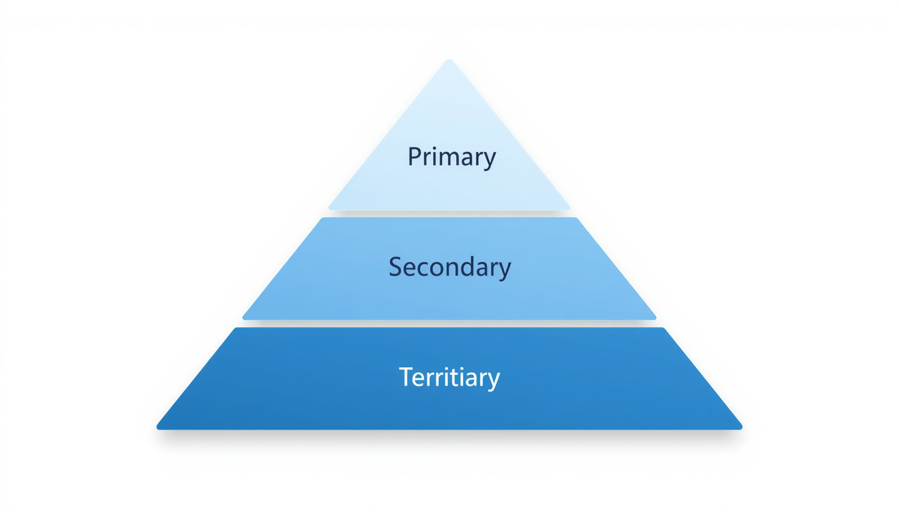
LEVELS
OF CARE
Primary Care
The first point of contact for patients. Delivered by general practitioners, community clinics, and health centres. Focuses on health promotion, disease prevention, routine diagnosis, and management of common illnesses.
Secondary & Tertiary Care
Secondary care involves specialist services provided by hospitals upon referral. Tertiary care offers highly specialised treatment for complex conditions, including advanced surgery, oncology, and intensive care, typically in major teaching or specialist hospitals.

Slide 5

PHILOSOPHY OF
MSQH
MSQH's philosophy is built on four core principles that guide the accreditation process and drive healthcare excellence across all facilities. These principles ensure that quality improvement is not merely a compliance exercise, but a deeply embedded culture within every healthcare organisation.
• Educational-Peer Review: Learning through structured peer assessment and shared knowledge among healthcare professionals.
• Enhancing Patient Safety: Prioritising safe environments and reducing adverse events for all patients.
Educational-Peer Review
Creating Quality Culture
Continuous Quality Improvement
Promotes learning through structured peer assessment, enabling healthcare professionals to share knowledge and improve practice standards collaboratively.
Fosters an organisational mindset where quality is embedded in every process, decision, and interaction across all levels of the healthcare facility.
Drives ongoing enhancement of healthcare services through systematic review, measurement, and implementation of best practices and standards.

Slide 6



IMPLEMENTATION
STRATEGIES
Engaging
A five-step approach guides healthcare facilities through the MSQH accreditation journey, building capability and ownership at every level of the organisation.
Actively involving all stakeholders clinical staff, administrators, and patients in the quality improvement process to foster a shared culture of excellence.
Education
Evaluating / Peer Review Validation
Building awareness and knowledge of MSQH standards among healthcare professionals, management, and staff across all levels of the organisation.
Assessing performance through internal audits and external peer review to validate compliance, identify gaps, and sustain continuous quality improvement.
Enabling
Empowering
Providing the necessary resources, systems, and structural support to allow healthcare facilities to implement and comply with accreditation standards effectively.
Equipping staff with the authority, tools, and confidence to drive quality improvement independently and take ownership of standards compliance.

Slide 7

Safety Culture
VALUE OF MSQH
Fostering a proactive environment where patient safety and staff well-being are prioritised at every level of healthcare delivery and organisational decision-making.
MSQH is guided by five core values that underpin every aspect of healthcare accreditation. These values reflect our commitment to excellence, safety, and continuous improvement across all healthcare facilities and services in Malaysia.
Integrity
Upholding honesty, transparency, and strong moral principles in all accreditation processes, assessments, and interactions with healthcare facilities and stakeholders.
Professionalism | Patient & People Centered | Teamwork
Professionalism: Demonstrating competence, ethical conduct, and accountability in all engagements.
Patient & People Centered: Placing patients, families, and communities at the heart of quality care.
Teamwork: Collaborating across disciplines to achieve shared goals of quality and safety.

Slide 8


THE QUALITY MEASUREMENT FRAMEWORK
Quality measurement is the foundation of effective healthcare accreditation. It provides a structured approach to evaluating healthcare performance, identifying areas for improvement, and ensuring that services meet established standards of safety and excellence.
The Quality Measurement Framework used by MSQH defines the dimensions, tools, and methodologies that guide healthcare facilities in monitoring, assessing, and continuously improving the quality of care delivered to patients and communities.
Dimensions of Quality
Explores accessibility, safety, competency, responsiveness, efficiency, sustainability, appropriateness, and patient-centered care as core quality domains.
CQI and Outcomes
Continuous Quality Improvement drives the link between structure, process, and outcome to achieve measurable improvements in healthcare service quality.
This section introduces the core components of the framework, including the dimensions of quality, the Donabedian operational model, and the principles of Continuous Quality Improvement (CQI) that underpin the MSQH accreditation process.

Slide 9
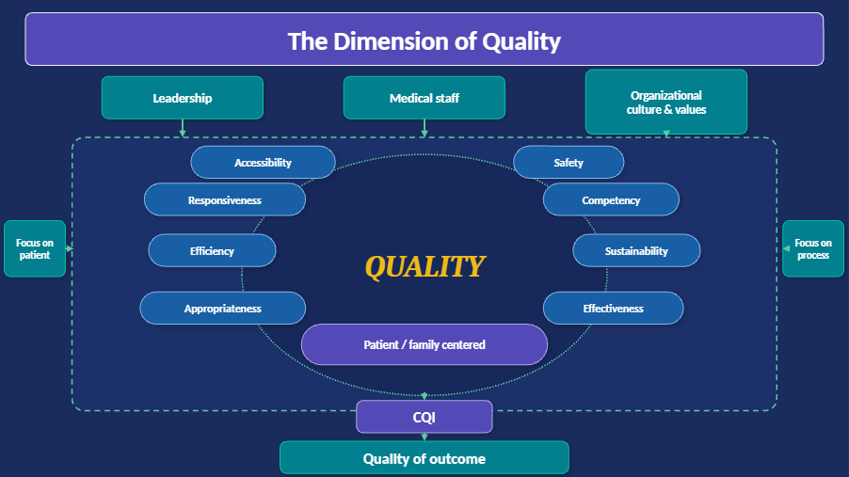
THE DIMENSION
OF QUALITY

Slide 10

OPERATIONAL MODEL
(DONABEDIAN)
Process
Structure
• Assessment and treatment planning
• Medication administration
• Clinical procedures
• Standard protocols and practice guidelines
• Doing the right things right, on time
• Size and category of organisation
• Layout and design of facility
• Safety features
• Number and types of personnel
• Equipment and resources
OUTCOME
• Clinical results: short-term, complications, adverse events, mortality
• Functional outcomes
• Perceived outcomes: patient & family satisfaction and experience
• Improvement in health status

Slide 11

BUILDING, SUSTAINING AND UPLIFTING ORGANISATIONAL QUALITY & ACCOUNTABILITY
Accreditation of Healthcare Facilities and Services
Tool to Demonstrate Accountability
=

Slide 12

ORGANISATIONAL QUALITY
Corporate Governance
A system directing and controlling organisational activities and stakeholder relations.
• Private Healthcare Facilities & Services Act 1998
• Medical Act 1971 & related regulations
• Hospital operational policies and bylaws
• Board accountability and strategic oversight
• Financial and operational compliance
Clinical Governance
Hospital accountability to patients through continuous monitoring and improvement of clinical services.
• Related healthcare acts and regulations
• Medical staff bylaws and credentialing
• Clinical and service standards compliance
• Mortality review and incident reporting
• Continuous Quality Improvement (CQI)

Slide 13
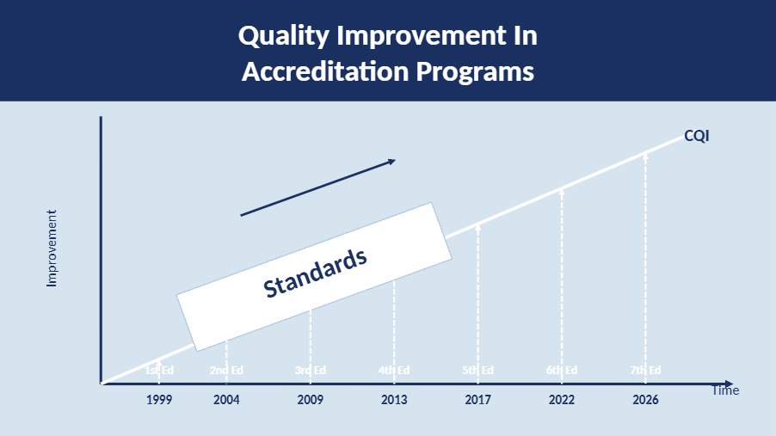
QUALITY IMPROVEMENT
Both the evolving standards and CQI framework work together to contribute to the provision of high-quality, safe healthcare services and improved patient health outcomes.

Slide 14

QUALITY IMPROVEMENT
GOAL
Both the Standards and Continuous Quality Improvement (CQI) aim to:
• Contribute to the provision of high-quality and safe healthcare services for all patients and communities
• Improve patients' health outcomes through systematic and evidence-based approaches to care delivery
By aligning organisational performance with established accreditation standards, healthcare facilities are better equipped to:
• Reduce clinical errors and adverse events
• Foster a culture of safety, accountability, and continuous learning
• Ensure that every patient receives care that is effective, timely, and patient-centered

Slide 15

MSQH HOSPITAL ACCREDITATION STANDARDS TIMELINE
1st Edition: 1999–2003
2nd Edition: 2004–2008
3rd Edition: 2009–2012
4th Edition: 2013–June 2017
5th Edition: July 2017–2021
6th Edition: 2022–Aug 2026
7th Edition: Sept 2026–2030
Each edition introduced progressively higher standards, reflecting MSQH's commitment to continuous quality improvement in Malaysian healthcare facilities and services.
The 4th and 5th Editions marked a significant shift toward patient-centered care and stronger clinical governance frameworks across all accredited facilities.
The 7th Edition incorporates ISQua's latest principles including Sustainable Care, Digital Care & AI, and Supporting Care Workforce setting a new benchmark for healthcare excellence.

Slide 16

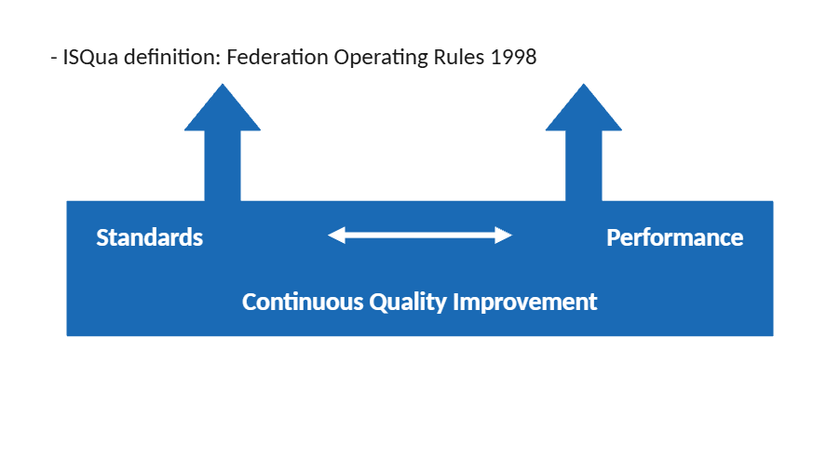
WORKING DEFINITION OF
ACCREDITATION
"Accreditation is a self-assessment and external peer review process used by healthcare organizations to accurately assess their level of performance in relation to established standards and to implement ways to continuously improve the healthcare system."
— ISQua Federation Operating Rules, 1998

Slide 17



Certification – High Performance Organisation
High Performance Organisation
(Safe Healthcare Facilities & Services)
MSQH
CERTIFICATION
Accreditation Survey & Pre-requisite
ROADMAP
Validation of organisation-wide performance through external peer review.
A four-level pyramid framework guiding healthcare facilities from basic licensing compliance to achieving high-performance certification. Each level builds upon the previous, demonstrating progressive commitment to quality, safety, and continuous improvement in healthcare services.
Pre-requisite
Pre-requisite requires organisational achievement in self-assessment and Continuous Quality Improvement (CQI).
Licensing (MOH) – Foundation Level
Compliance with the Private Healthcare Facilities and Services Act 1998 (Act 586) & Regulations 2006, plus all other applicable laws. Mandatory baseline for all healthcare facilities before pursuing accreditation.

Slide 18

LAWS GOVERNING HEALTHCARE FACILITIES
Healthcare facilities in Malaysia operate within a comprehensive legal framework comprising more than 50 laws and regulations. These laws govern the establishment, operation, and management of healthcare facilities and services across the country.
This section provides an overview of the key legislative categories that healthcare organizations must comply with, ensuring patient safety, professional standards, and accountability in the delivery of healthcare services.
Legal Framework Overview
More than 50 laws regulate healthcare facilities, providers, and services in Malaysia, spanning multiple categories of legal obligations.
Key Legislation: Act 586
The primary legislation governing private healthcare facilities is the Private Healthcare Facilities and Services Act (PHFSA) 1998 (Act 586) and its Regulations 2006. This Act forms the legal basis for the accreditation of healthcare facilities and services in Malaysia.
The Private Healthcare Facilities and Services Act 1998 is the primary act justifying standards for healthcare facilities and services in Malaysia.

Slide 19

Laws Regulating Healthcare Providers, Facilities & Services
MORE THAN 50 LAWS
Regulates private and public healthcare providers, facilities, and the services they deliver. Includes Act 586 (PHFSA 1998) as the cornerstone legislation for healthcare standards.
Laws Related to Healthcare Facilities Not Under Ministry of Health
Governs healthcare facilities that fall outside the direct purview of the Ministry of Health, including those under other ministries or statutory bodies.
Laws Imposing Duty of Doctors & Disease Control
Category 3: Laws imposing duty of doctors — professional obligations and ethical responsibilities.
Category 4: Laws of Control of Disease — prevention, containment and management of communicable diseases.
Category 5: Laws related to Health in General — broad public health legislation.
Category 6: Laws related to Financing — healthcare funding and insurance frameworks.
Category 7: Legal Provision for Healthcare Costs — regulations on fees and cost transparency.

Slide 20

ACT 586
PHFSA 1998 & REGULATIONS 2006
The Private Healthcare Facilities and Services Act (PHFSA) 1998, also known as AKTA 586, along with its Regulations 2006, has been enforced since 2006. This is the only Act in Malaysia that specifically justifies and mandates the establishment of standards for healthcare facilities and services.
Act 586 provides the legal framework governing all private healthcare facilities and services in Malaysia, ensuring minimum standards are upheld across the sector.
MSQH accreditation standards are developed in alignment with Act 586, ensuring that accredited facilities comply with the legal requirements set forth under PHFSA 1998 & Regulations 2006.

Slide 21



ACT 586:
Professionalism
OBJECTIVES
Ensure professionalism among healthcare professions by maintaining high levels of competence, skill, and ethical conduct in the delivery of healthcare services.
PHFSA 1998
Quality of Healthcare Facilities
Minimum Standards
Ensure quality assurance in healthcare facilities including mortality review, incident reporting, and continuous improvement activities.
Impose and ensure minimum standards in private healthcare facilities and services to guarantee a consistent baseline of safe and quality care for all patients.
Social and National Interest
Integrity
Address broader social and national interests to ensure healthcare services contribute positively to the well-being of the population and nation.
Ensure integrity among healthcare professionals upholding honesty and strong moral principles in all aspects of clinical practice and patient interaction.

Slide 22

FOCUS OF MSQH
ACCREDITATION
The focus of MSQH Accreditation is on the patient and staff to ensure:
• Safe treatment for patients Accreditation standards are designed to ensure that every patient receives care that is safe, effective, and of the highest quality.
• Safe environment for staff A safe working environment enables healthcare professionals to perform their duties with confidence, competence, and care.

Slide 23

FOCUS ON
PATIENT SAFETY
Accreditation places strong emphasis on structure, process, risk management, outcome measurement, and Continuous Quality Improvement (CQI). It is fundamentally a risk reduction activity aimed at minimising errors and adverse events in healthcare delivery. When standards are consistently met or surpassed, the result is a safer, higher-quality healthcare environment for both patients and staff.

Slide 24



Facilitate Continuous Improvement
IN ESSENCE
Create Consistency Throughout the Organisation
A well understood and effectively implemented system within a healthcare organisation provides the foundation for sustained excellence. The following key benefits demonstrate how a structured approach transforms organisational performance and patient care delivery.
Improve Decision-Making
Reduce Dependence on Individuals

Slide 25



Changes in Professional Practices
IN ESSENCE
Managerial and Organisational Changes
A well understood and implemented quality system also helps the organisation drive meaningful change across professional and managerial dimensions, leading to improved performance, better clinical outcomes, and a culture of standardised, consistent practice throughout the facility.
Improves business performance and clinical outcomes
Uniformity and Standardisation of Practices

Slide 26

"QUALITY HAS TO BE MANAGED; IT WILL NOT JUST HAPPEN"

Slide 27



THANK YOU!
Malaysian Society for Quality in Health
We hope this presentation provided a comprehensive overview of MSQH and the 7th Edition Service Standards.
Contact Us
Website
+603-7726 1999
www.msqh.com.my

Slide 28

COPYRIGHT
© Malaysian Society for Quality in Health (MSQH)
All rights reserved.
No part of this presentation, including text, graphics, images, and other material, may be reproduced, distributed, transmitted, displayed, published, or broadcast in any form or by any means without the prior written permission of the Malaysian Society for Quality in Health.
Unauthorized reproduction or distribution of this material, or any portion thereof, may result in civil and criminal penalties and will be prosecuted to the maximum extent possible under the law.
For permissions and enquiries, please contact:
Malaysian Society for Quality in Health (MSQH)
www.msqh.com.my

